Slide 1

MACHINE LEARNING
project’s presentation
Presented by : Seemal Mustafa
2023-BS-AI-013

Slide 2



CLASSIFICATION
Diabetes Classification Using Machine Learning
PROJECT OVERVIEW:
Develop a machine learning model to classify individuals as diabetic or non-diabetic using health-related features (age, BMI, blood pressure, lifestyle factors).

Slide 3
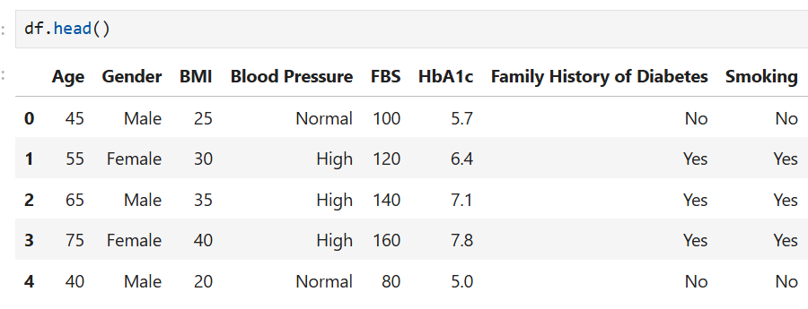
DATASET
DATASET PROJECT 2:
•128 samples, 11 features (numerical: Age, BMI, FBS, HbA1c; categorical: Gender, Blood Pressure, etc.).
•Target: Diagnosis (Diabetic/Non-Diabetic).

Slide 4
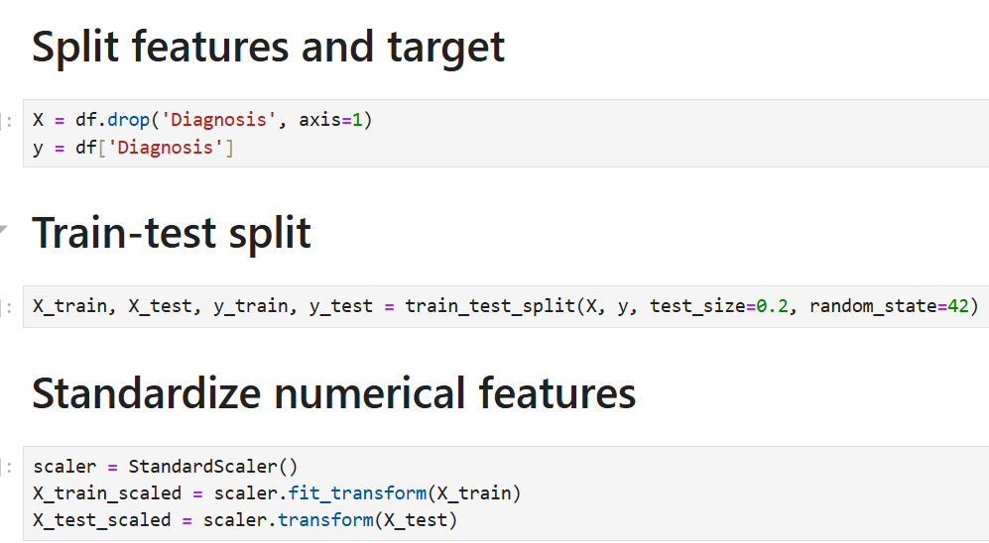

PROCESSING STEPS
Key Processing Steps:
•Preprocessing
•Encoded categorical variables
•Split data
•Scaled numerical features
•Random Forest
•Logistic Regression
•ANN
•Confusion matrices used to assess accuracy.

Slide 5
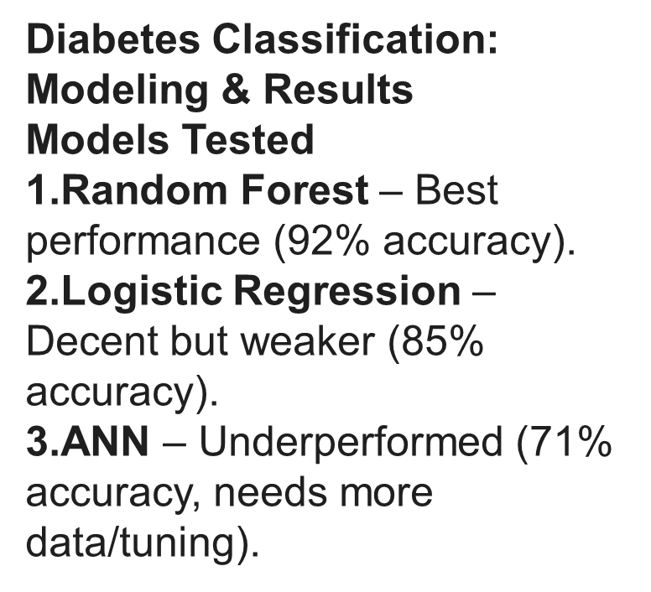
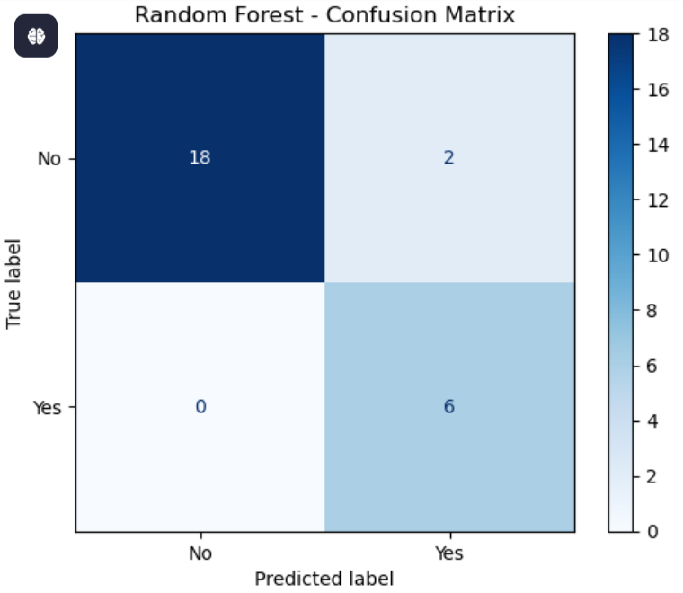
MODELING AND EVALUATION

Slide 6
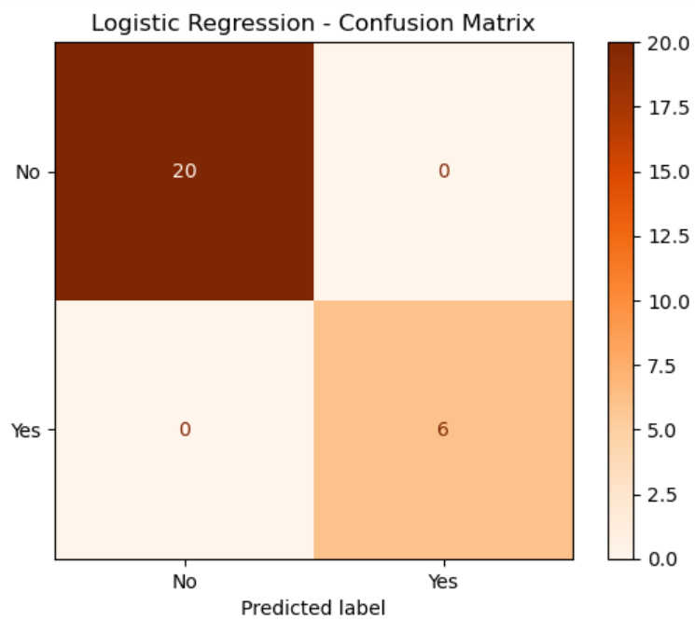
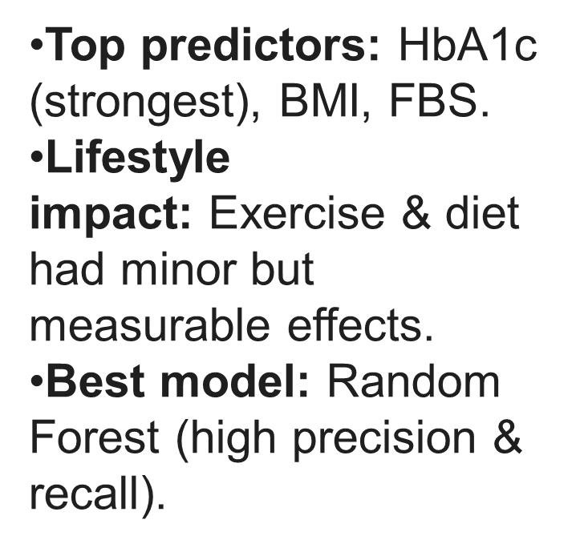
KEY FINDINGS

Slide 7


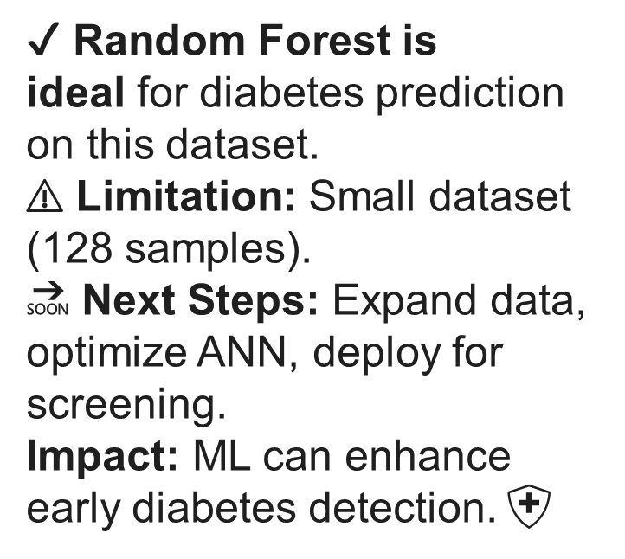
CONCLUSION

Slide 8
Thank you very much!

